Slide 1
Moving Toward Monotheism
AP World History Notes
Chapter 5
Eurasian Cultural Traditions

Slide 2
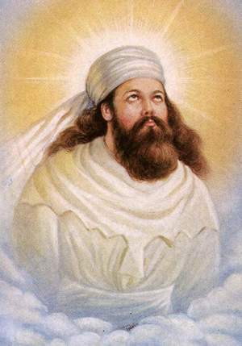
Moving toward Monotheism
Zoroastrianism = emerged in the Persian Empire around the 6th or 7th century BCE
Followed the teachings of prophet named Zoroaster
  Said there was a struggle between good and evil in the world
  Ahura Mazda vs. Angra Mainyu
  Humans caught in the middle of this struggle and had to choose sides
  Humans who chose good would get eternal life
  Humans who chose evil would get darkness & misery after death
  Big emphasis on the free will of humankind

Slide 3
Zoroastrianism
Did not spread widely beyond the Middle East because it was not an active missionary religion
Invasions of Alexander the Great devastated Zoroastrianism → temples destroyed, priests slaughtered, sacred writings burned
Arrival of Islam in the Middle East also led to the final decline of Zoroastrianism

Slide 4
Zoroastrianism
Elements that remain within Judaism and Christianity:
  Good versus evil
  God versus an evil counterpart
  Idea of a last judgment & resurrected bodies
  Belief in final defeat of evil
  Arrival of a savior (Messiah)
  Remaking of the world at the end of time

Slide 5
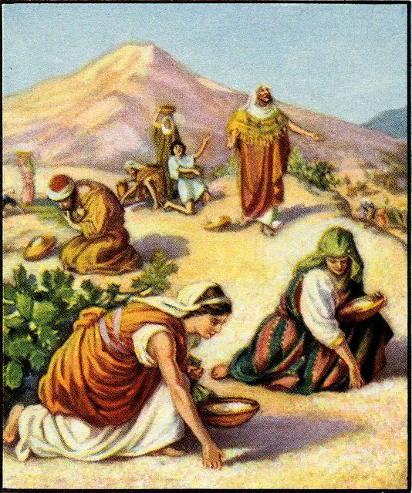
The Israelites
Most cultures of the ancient world worshipped many gods
  The Israelites (living in Canaan) = monotheistic = belief in only 1 God
  Commands of God revealed by prophets = holy messengers
  God called: Yahweh
  Yahweh determined right & wrong and the people had to accept moral responsibility for their actions

Slide 6
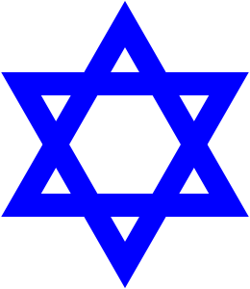
The Israelites
Teachings of the Israelites exist today as religion of Judaism
  Shares many beliefs with Christianity and Islam

Slide 7
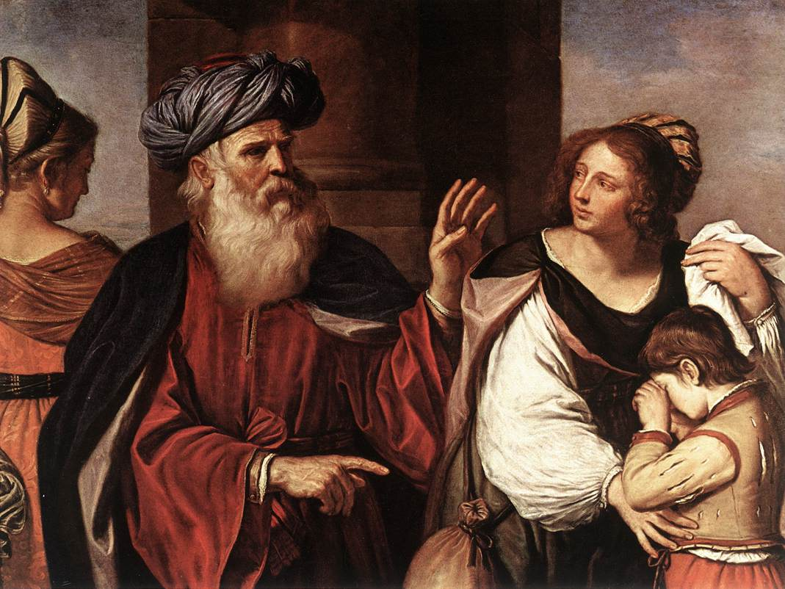
The Land of Canaan
Bible remains one of the main sources of ancient history in Fertile Crescent
  Bible traces origins of the Israelites to Abraham = herder/trader from Ur in Mesopotamia
  Says God made a covenant (agreement) with Abraham to make a great nation for the Hebrews
  Traveled to Canaan --> shared land with Phoenicians & Philistines

Slide 8
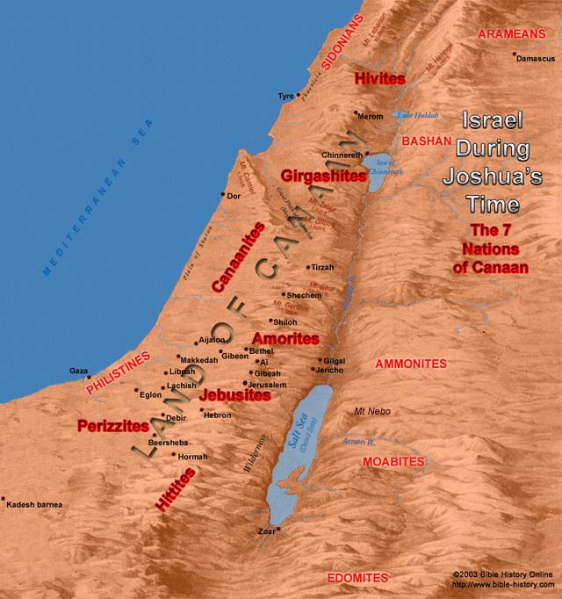
The Land of Canaan
Many people in Canaan lived as nomads herding sheep and goats
  Usually wandered around valley of Jordan River = farming land

Slide 9
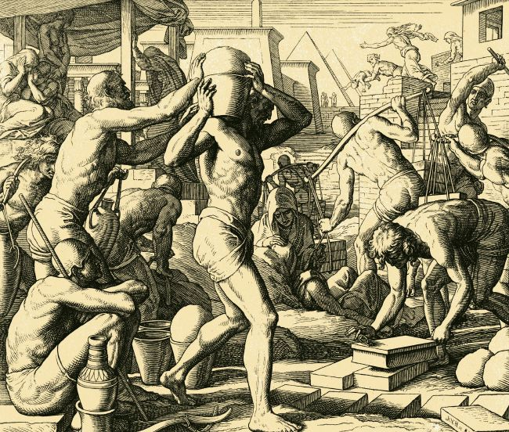
The Exodus from Egypt
Abraham’s grandson Jacob raised 12 sons in Canaan
  Each son led a separate tribe = family group
  12 tribes migrated to Egypt to escape famine --> eventually were enslaved by the Egyptians

Slide 10
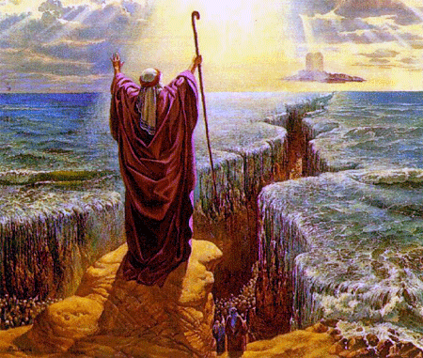
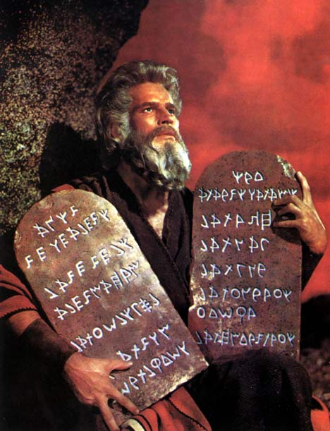
The Exodus from Egypt
Prophet Moses led the Israelites out of Egypt to the Sinai Desert in a mass exodus = departure
  During the journey, God gave Moses the 10 commandments
  Exodus story retold by Jewish people at Passover every year

Slide 11
Settling the Land
Moses died before arrival at Canaan --> successor, Joshua, led Israelites
For 200 years = Israelites fought the Philistines for control of the land
Lack of unity among the 12 tribes made fighting difficult
  Continued warfare led tribes to unite under 1 king = Saul

Slide 12
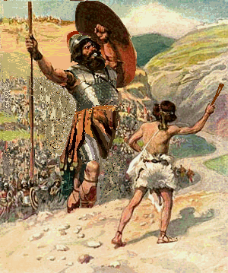
Settling the Land
Saul couldn’t help them defeat Philistines & David took the throne
  David was popular because he defeated the Philistine Goliath
  David set up capital of Jerusalem
  Set up a central government, enlarged the kingdom’s borders, brought economic prosperity

Slide 13
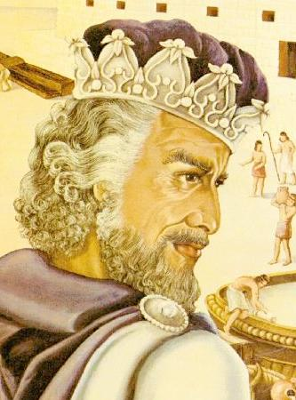
Settling the Land
David’s son Solomon took over after him
  Unpopular because he made high taxes to pay for new cities and temples
  After his death, 10 northern tribes broke away from 2 southern tribes
    Northern tribes kept the name Israel
    Southern tribes took the name Judah

Slide 14
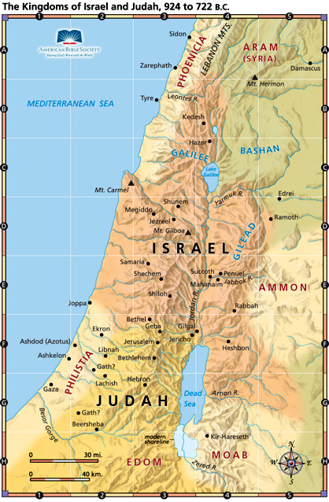
Exile and Return
2 kingdoms were too weak to resist invaders
722 BCE = Assyrians (from Mesopotamia) conquered Israel
586 BCE = Chaldeans (from Mesopotamia) gained control of Judah

Slide 15
Exile and Return
Israelites were enslaved and exiled to Babylon
During this time, the Jews had no temple so they met on the holy day of rest together for study and prayer
  Rise of synagogues developed from these gatherings

Slide 16
Exile and Return
539 BCE = Persians conquered the Chaldeans
  Persian king allowed the Jews to return to Judah and to rebuild the temple

Slide 17
Exile and Return
400s BCE = Jewish holy writings organized into the Torah = made up the first 5 books of the Bible
Since this time, Jewish communities have existed outside their homeland = called Jewish Diaspora

Slide 18
A Lasting Legacy
Jews recorded their history & examined it for meaning
Prophets recorded their teachings
Jewish religious beliefs & principles helped shape Christianity in the future

Slide 19
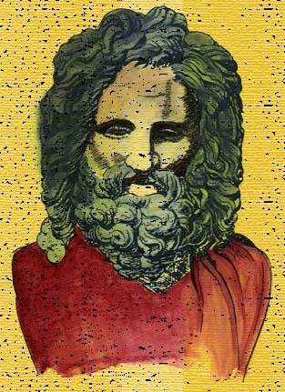
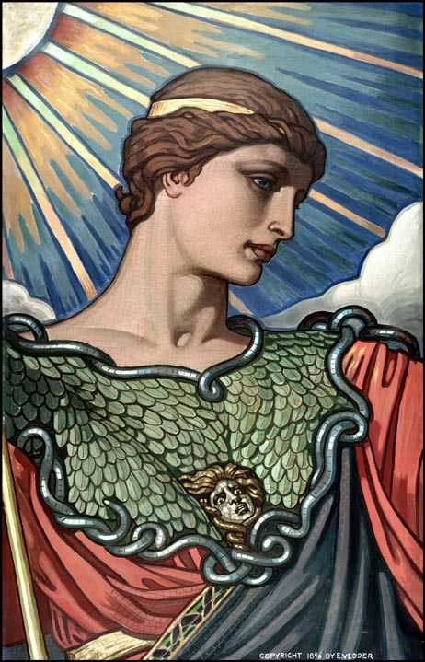
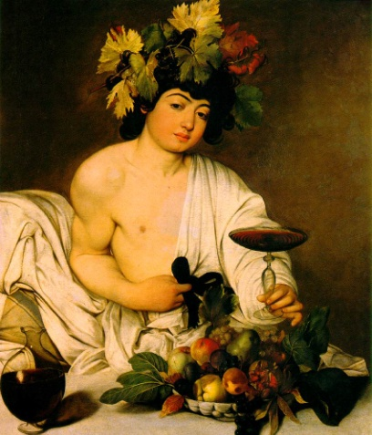
Recap of Religion in Ancient Rome
Early Romans worshipped nature spirits
Romans then adopted Greek religion and gave gods Roman names
Under Augustus: people expected to honor the emperor as Rome’s chief priest
Jupiter
Minerva
Bacchus

Slide 20
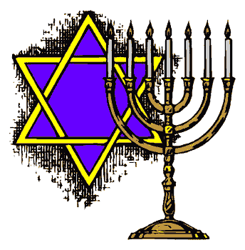
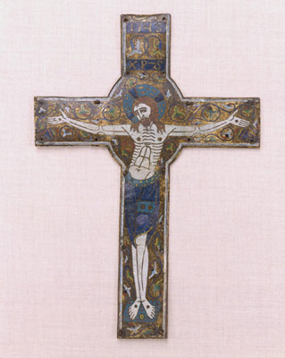
Recap of Religion in Ancient Rome
But empire’s people allowed to worship freely
Many religions existed in the Roman Empire
Some Jews began practicing a new religion called Christianity
  Considered a sect (group) within Judaism at first
  Became a separate religion

Slide 21
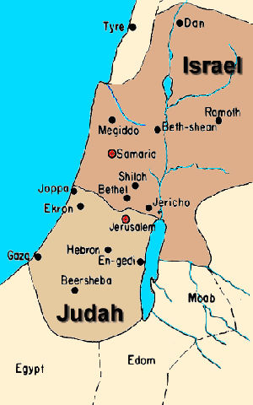
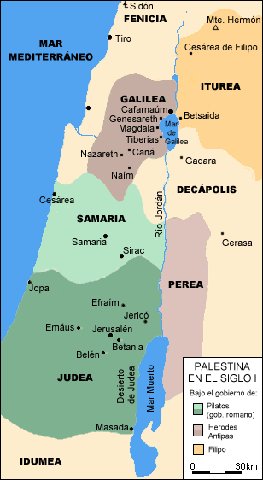
Judaism & the Empire
6 CE = Augustus turned kingdom of Judah into Roman province of Judea
Jews in Judea allowed to practice their religion, but treated very cruelly
  They hoped a messiah = deliverer chosen by god = would help them regain their freedom

Slide 22
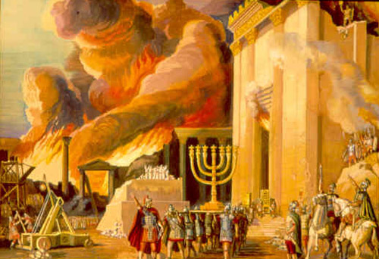
Judaism & the Empire
66 CE = Jews rebelled against Romans & took over Jerusalem
  4 years later = Romans retook Jerusalem, destroyed the Temple, and killed thousands of Jews
  Romans banned the Jews from living in Jerusalem

Slide 23
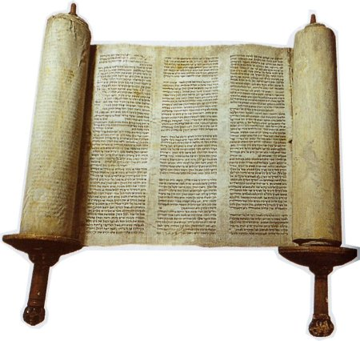
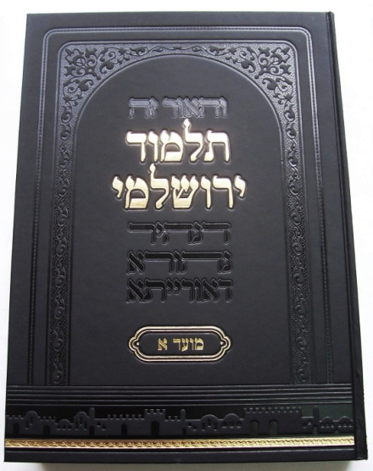
Judaism & the Empire
Jews continued to study the Torah in scattered communities throughout the Middle East
Jews set up yeshivas = special schools to train rabbis
Rabbis created the Talmud = important book of Jewish law

Slide 24
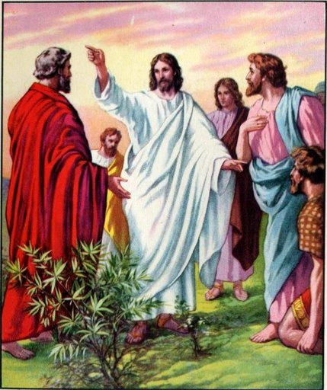
Jesus of Nazareth
Jesus preached a new message to his fellow Jews
  Traveled throughout Galilee and Judea
  Gained disciples = followers
  Said God was loving and forgiving
  Often used parables = symbolic stories

Slide 25
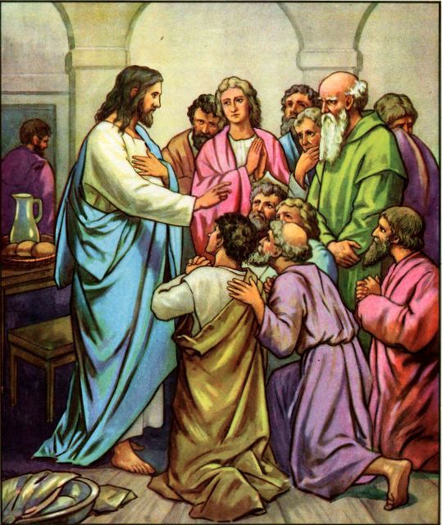
Jesus of Nazareth
Disciples believed Jesus was the Messiah
  Other Jews disputed this – believed the Messiah had not come yet

Slide 26
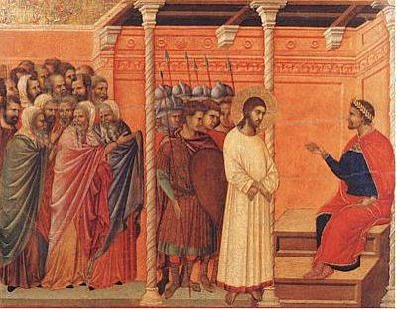
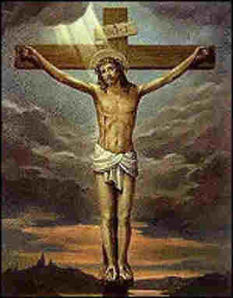
Jesus of Nazareth
Roman officials were troubled by the controversy over Jesus
  Roman governor Pontius Pilate arrested Jesus & ordered that he be crucified

Slide 27
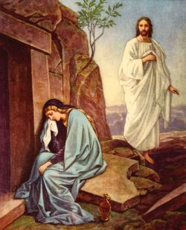
The Spread of Christianity
After Jesus' death, his disciples said he had risen from the dead
They began preaching that Jesus was the Son of God
  Those who accepted this message = called Christians
  Christians formed own churches for worship, fellowship, and instruction

Slide 28
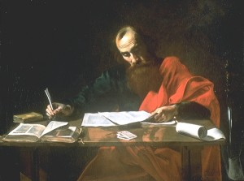

The Spread of Christianity
Paul = helped spread Christianity → especially to non-Jews
  Traveled all over and wrote letters about this new religion
  Letters along with the 4 Gospels (stories about Jesus) = combined with writings of other Christian leaders to form New Testament of the Bible

Slide 29
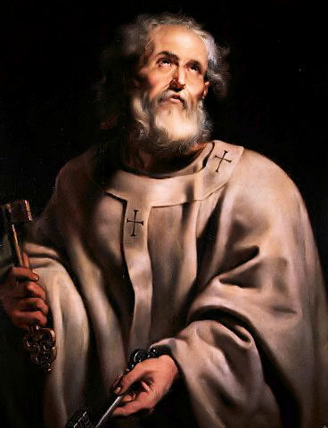
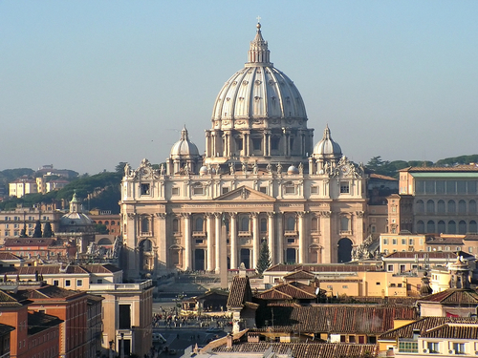
The Spread of Christianity
Apostles = Christian missionaries that spread Christianity in Roman world
  Peter = leader of the apostles → founded a church in Rome

Slide 30
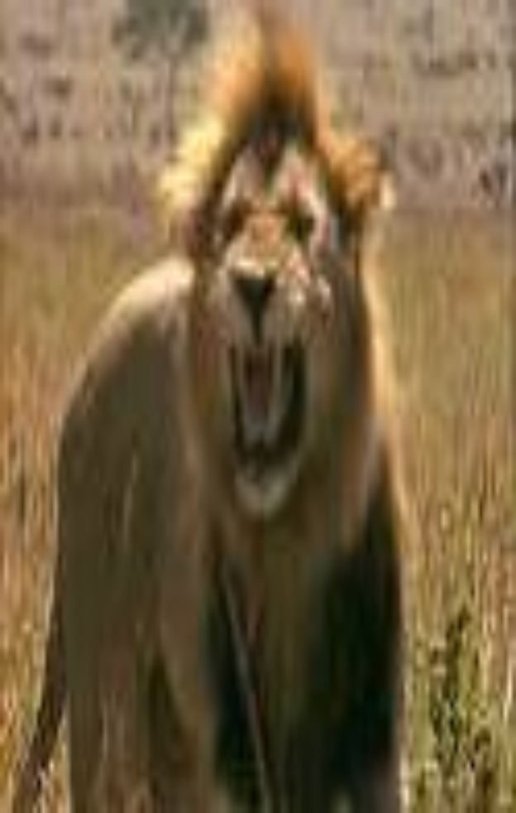
Persecution & Competition
Christians refused to honor the Roman emperor as a god & rejected military service --> many Romans accused them of treason
Christians seen as causing trouble could be killed
Christian martyrs = people who died for their beliefs - were often killed by wild beasts in front of cheering crowds

Slide 31
Persecution & Competition
Problems for Christians:
  Hard to get followers because followers often persecuted
  Had to compete with other polytheistic & mythical religions, as well as Judaism, for followers
Mainly a religion of the cities (so was Judaism)
    Traditional Roman religion = had a stronghold in the countryside

Slide 32
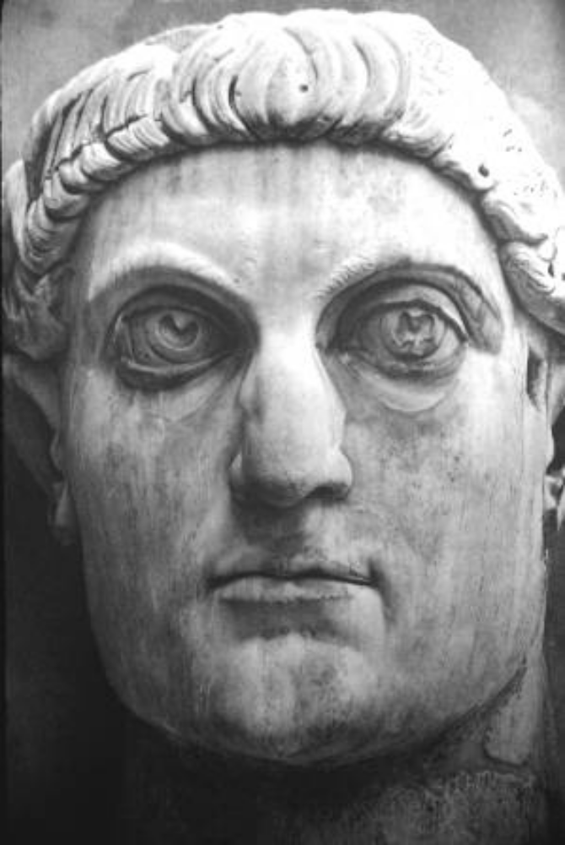
Romans Adopt Christianity
Constantine = Roman emperor who believed the Christian God had helped him win a battle
  Became protector of Christianity
  Issued the Edict of Milan = said all groups were free to worship as they pleased
Christianity increased in size & influence

Slide 33
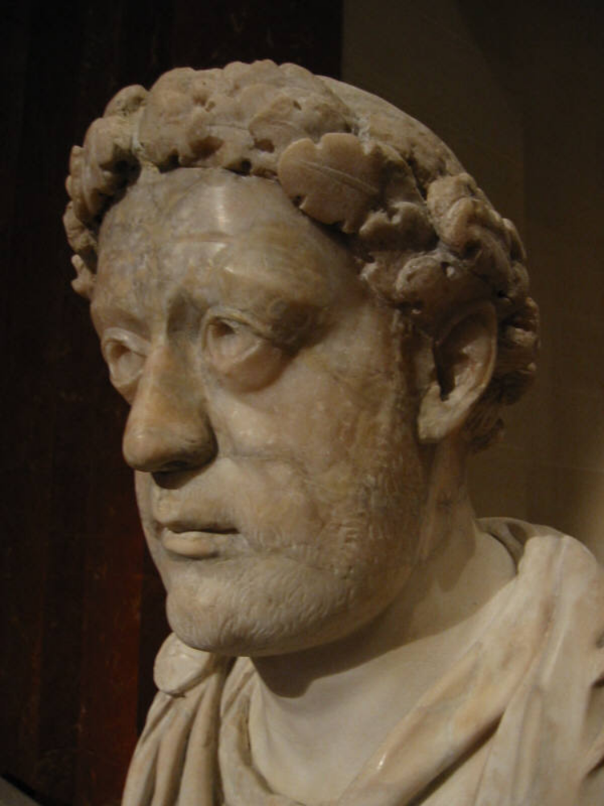
Romans Adopt Christianity
392 CE = Theodosius made Christianity the official religion of the Roman Empire
  He banned all other religions

Slide 34
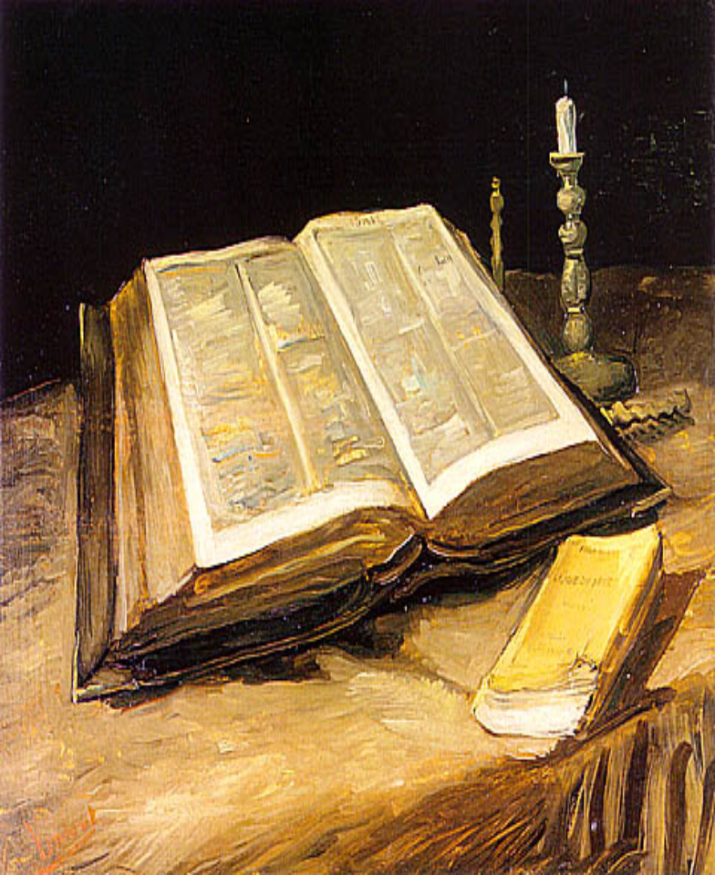
The Early Church
Christians felt that teachings had to be stated clearly to avoid differences in opinion that might divide the church
Church Fathers wrote books explaining Christian teachings

Slide 35
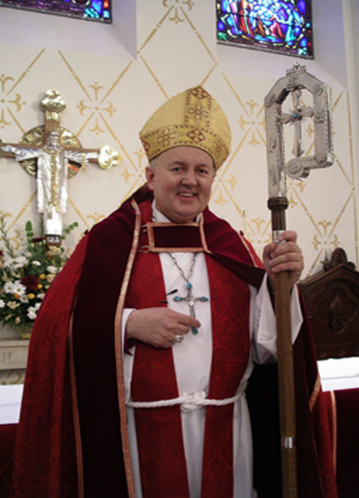
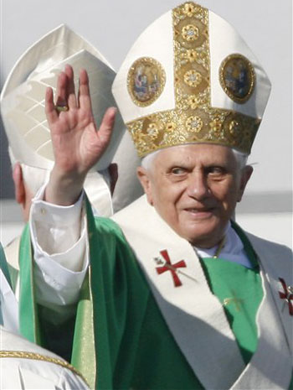
Church Structure
Church was organized into a hierarchy with levels of authority
  Parishes = local gatherings of Christians led by priests
  Diocese = several parishes grouped together
    Bishop = leader of the diocese
    Patriarchs = bishops of the 5 leading cities = Rome, Constantinople, Alexandria, Antioch, Jerusalem
    Bishop of Rome claimed authority over all other bishops --> he became the Pope = head of Roman Catholic Church

Slide 36
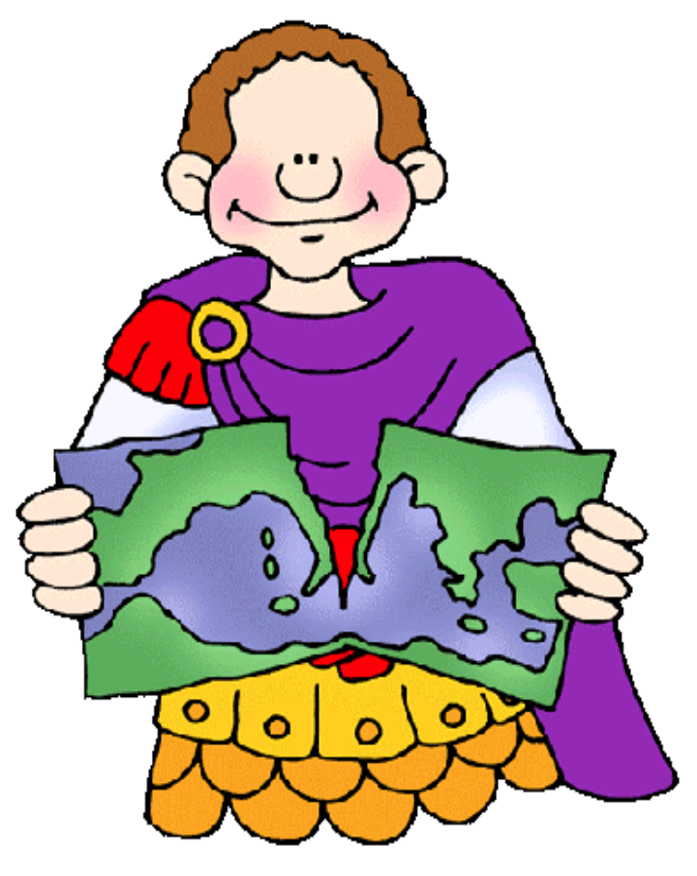
Church Structure
With the Pope came a split in Christianity
Churches in the western part of Roman Empire became known as the Roman Catholic Church
  Latin-speaking churches -- Believed in the Pope
Churches in the eastern part of the Roman Empire became known as the Eastern Orthodox Church
  Greek-speaking churches -- didn’t believe in the authority of the Pope

