Slide 1
INSTRUCTIONS: label the file as your p#_lastname_firstname_vietnam_map
first look at the globe image (slide 2) and familiarize yourself with the green area on the globe: the area is Southeast Asia.
Now look at slide 3 and study the locations of the labeled countries so you know where Vietnam is located. Look at the countries that border Vietnam: China, Laos, and Cambodia. Then look at Myanmar, Bangladesh, and India. Please note that Bangladesh is, but for a very small border with Myanmar, surrounded by India. Note where Nepal and Bhutan are located. Carefully look at Malaysia. It is part of the Thai-Malaysian peninsula and part of the Island of Borneo (which is not labeled, but Brunei [a country] is labeled). Singapore is a small island off the tip of Malaysia. Indonesia is everything under Malaysia and includes half of New Guinea.
Now look at slide 4 and quiz yourself on the names of the countries. Then label all of the countries on the blank map.
When you have finished labeling the blank map, download only slide 4 as follows: Select only slide 4 (it will have a yellow background).
File > Download > PNG image (.png current slide)
Email the completed map as an attachment.
On slide 5, label the United States, Great Britain, France, Russia (U.S.S.R.), China, North and South Korea, Vietnam, Laos, Cambodia, Japan, the Philippines, and Hawaii.
When you have finished labeling the blank map, download only slide 5 as follows:
File > Download > PNG image (.png current slide)
Email the completed map as an attachment.

Slide 2
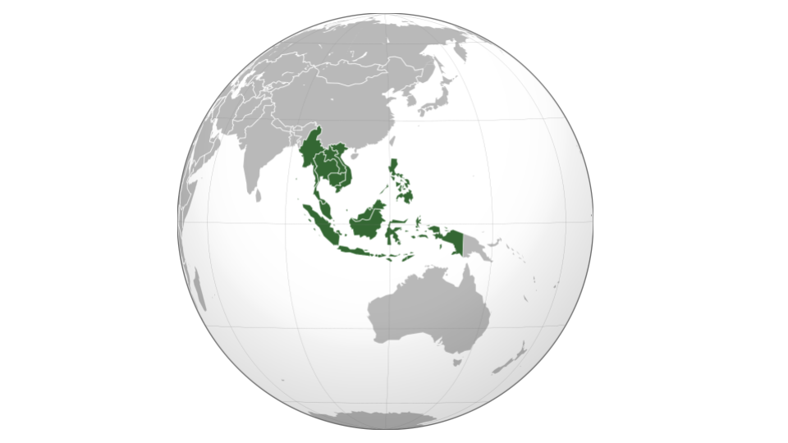

Slide 3
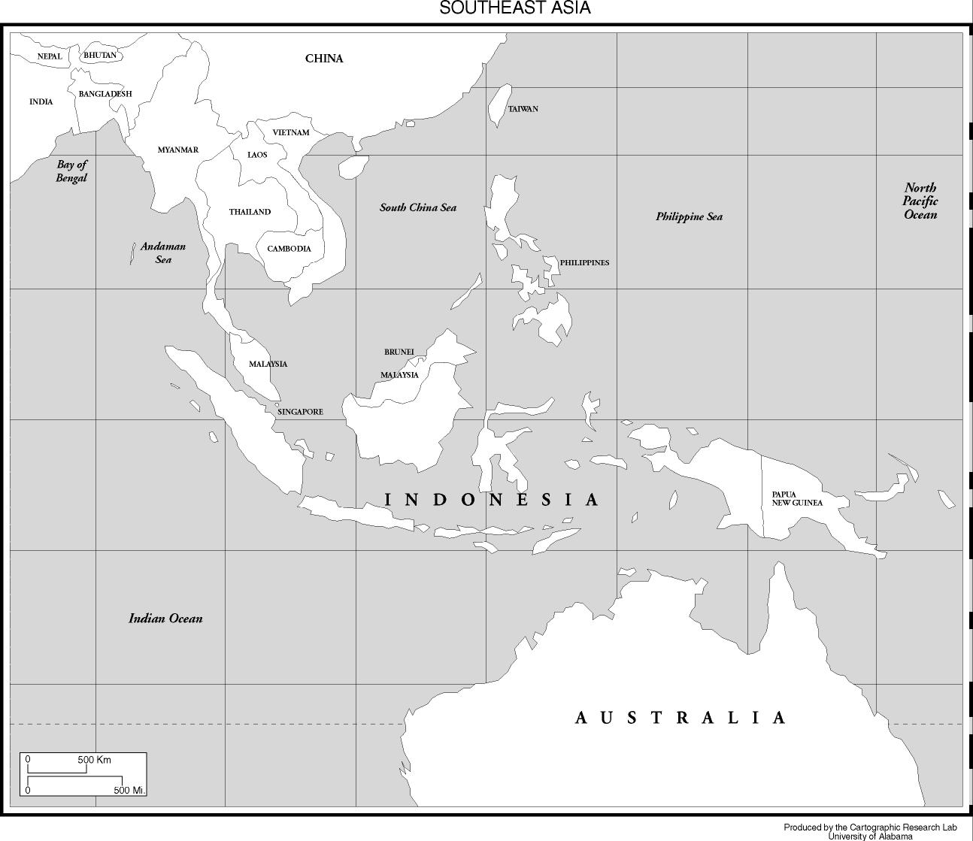

Slide 4
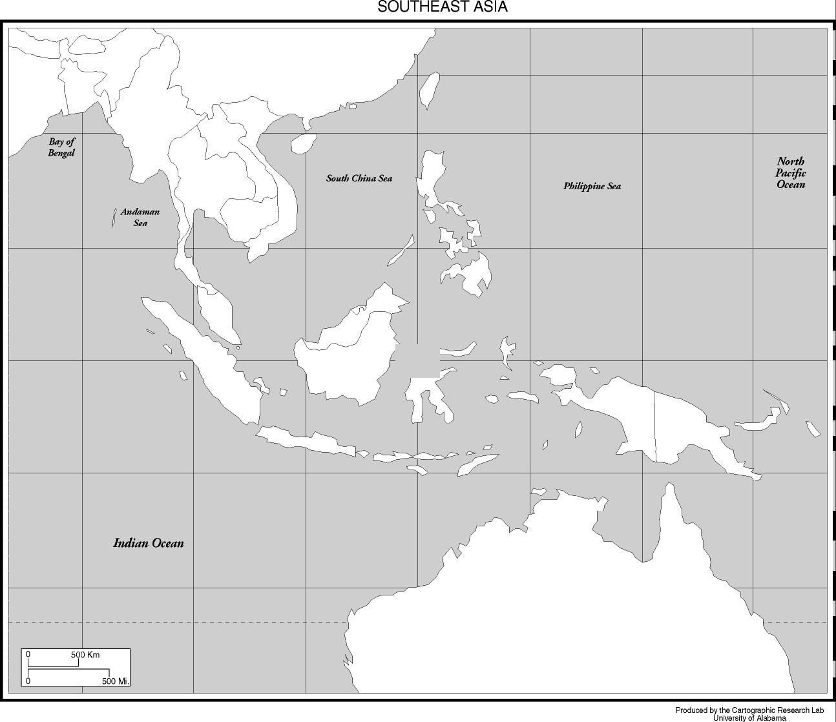

Slide 5
